Slide 1

DA 204o: Data Science in Practice Course Project Proposal Product Recommendation based on user interactions on it's purchases
Meenal Dhuria, IISc, meenaldhuria@iisc.ac.in
Kshitiz Singh, IISc, kshitizsingh@iisc.ac.in
Jyoti Pal, IISc, jyotipal@iisc.ac.in
Rishav Kumar Goswami, IISc, rishavg@iisc.ac.in

Slide 2
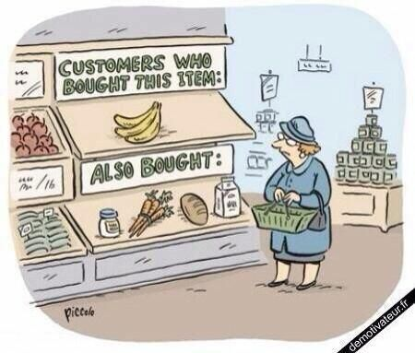
Problem Definition
Background: Recommending relevant products to customers is the key to improving user experience and sales. Analysing purchase history can reveal valuable insights into customer preferences.
Importance: Effective recommendations can increase customer retention and average order value, improving the overall shopping experience.
Objectives:
Build a recommendation system based on user behavior and item similarity based on user rating.
Use collaborative filtering (SVD and Co-Clustering) and content-based filtering(KNN) to predict relevant products.
How Data Science Can Help:
Machine learning can detect patterns and suggest products based on similar users and products, enhancing personalization.

Slide 3
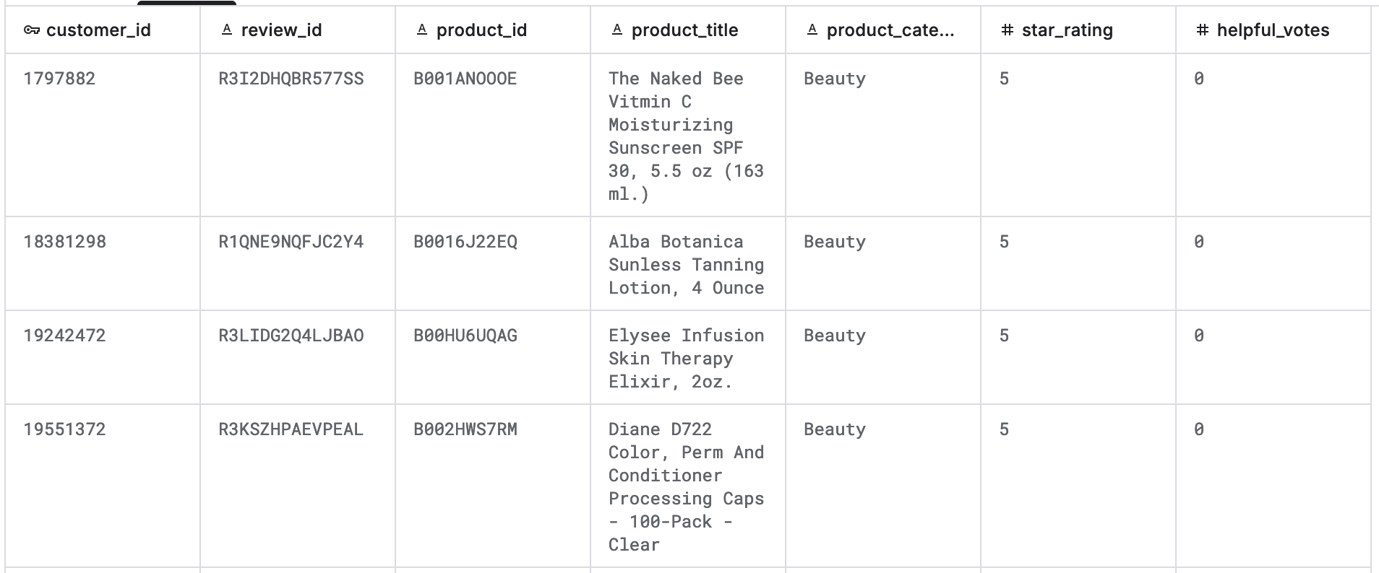
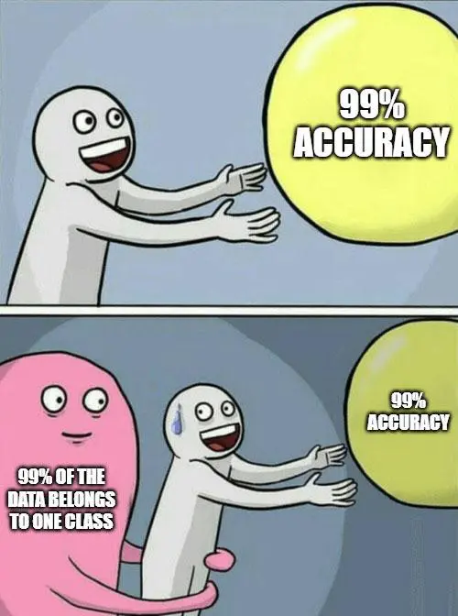
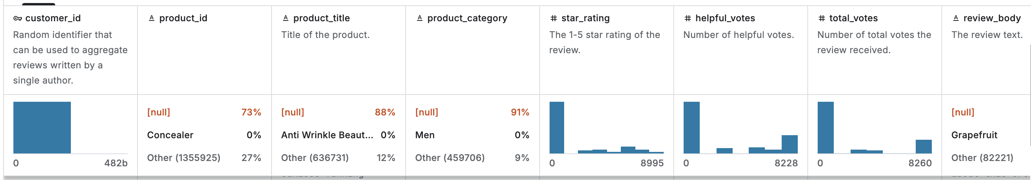
Data Collection and Preparation
Data Sources:
Using Amazon Customer Reviews Dataset for this project from Kaggle.
Data Description:
The dataset contains the customer review, star rating, helpful votes etc
There are total 15 feature columns capture in this dataset, but we will be majorly focus on following 7 columns for our project work.
The size of the data set as approx. ~ 2GB
Preprocessing:
Data cleaning (handling missing values, duplicates).
Feature extraction like categorizing products, validating review star rating
Splitting dataset in Train-Test for model building.

Slide 4
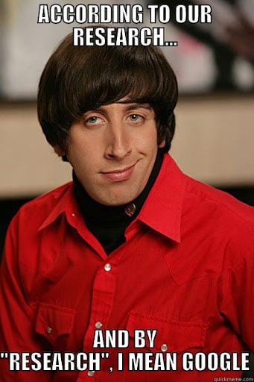
Proposed Methodology
Methods/Models:
There are multiple methods available for solution of the recommendation problem like:
Collaborative Filtering: Recommend based on user-item interactions.
Content-Based Filtering: Use product attributes for recommendations.
Hybrid Methods: Combining both approaches for better accuracy.
Justification:
Collaborative filtering captures user preferences, while content-based filtering ensures relevant products.
For our use case, we will be using “Collaborative Filtering and Content-based filtering”
Since, we have user and its interaction like `review` and `start rating` for their purchased products.
Tools/Technologies:
Python libraries like Pandas, Matplotlib, NumPy, Scikit-learn for recommendation algorithms, Scipy, Ipywidgets, random and Ipython.

Slide 5
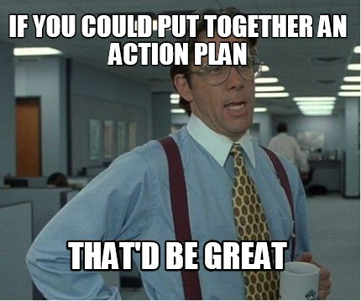
Implementation Plan
Phases:
Data Collection and Preparation (Preprocessing data).
Exploratory Data Analysis (EDA) and Feature Engineering.
Model Development (Collaborative and Content-based).
Testing, Validation, and Tuning.
Final Model Deployment and Presentation.
Timeline: Breakdown of tasks across the 6-week project period.
Resources Needed:
Python, Jupyter Notebook.
Hardware for model training (GPU if necessary).
Referred Links-
https://www.kaggle.com/datasets/cynthiarempel/amazon-us-customer-reviews-dataset
https://www.ibm.com/topics/collaborative-filtering#:~:text=Collaborative%20filtering%20is%20an%20information,have%20interacted%20with%20that%20item.
https://amazon-reviews-2023.github.io/
https://en.wikipedia.org/wiki/Collaborative_filtering

Slide 6

Challenges and Risks
Challenges:
Sparse data (many products and users, but limited interaction).
Cold-start problem (new users/products with little data).
Imbalanced distribution of ratings and metadata availability.
Computational expense of hyper-parameter tuning.
Mitigation Strategies:
Implement content-based filtering for new users.
SVD uncovered latent features effectively.
Co-Clustering added interpretable cluster-level insights.
kNN addressed cold-start issues with reliable metadata.

Slide 7

Expected Outcome
Outcome:
This project demonstrates the value of combining collaborative and content-based filtering for recommendation systems. SVD emerged as the most effective model, while
kNN ensured reliable recommendations for content-driven queries. Future work includes exploring hybrid models to mitigate sparsity and cold-start challenges.
Success Metrics:
Accuracy of recommendations (Precision and Recall).
Root Mean Square Error (RMSE) for prediction accuracy.

Slide 8

Role and Responsibilities
Students: Meenal Dhuria, Rishav Kumar Goswami
Data Collection and Preparation.
Model Development (Collaborative).
Testing, Validation, and Tuning of the model.
Final Model Deployment and Presentation.
Students: Jyoti Pal, Kshitiz Singh
Exploratory Data Analysis (EDA) and Feature Engineering.
Model Development (Content-based).
Testing, Validation, and Tuning of the model.
Final Model Deployment and Presentation.

Slide 9
Data Science Canvas |  |  | Project: | Product Recommendation based on user interactions on its purchases
 |  |  | Team: | Meenal Dhuria, Rishav Kumar Goswami, Jyoti Pal, Kshitiz Singh
Problem Statement |  |  |  | Execution & Evaluation |  | Data Collection & Preparation
Business Case & Value Added Business Case: Providing personalized recommendations increases the likelihood of repeat purchases and enhances customer satisfaction. Value Added: Improved customer experience by offering tailored product suggestions. Increased sales by encouraging customers to buy more based on prior purchases. Higher customer retention due to better engagement. | Model Selection Methods Considered: Collaborative Filtering (Matrix Factorization, User-Item Similarity). Content-Based Filtering (Product attributes, User preferences). Reasoning: Collaborative filtering is ideal for finding patterns in customer behaviour, while content-based ensures relevant product suggestions using product attributes. For our use-case, we will be using “ Collaborative Filtering and content-based filtering” Since, we have user and its interaction like `review` and `start rating` for their purchased products. | Model Requirements Requirements: Handle large datasets efficiently. Account for sparse interactions (few interactions per user). Minimize cold-start issues for new users/products. Validation: Use metrics like Precision, Recall and RMSE to validate the recommendation model. | Skills Proficiency for collecting and preparing the data. Understanding and having the expertise in Python and it's libraries Strong foundation in probability, linear algebra Understanding of performance metrics such as accuracy, precision etc | Model Evaluation Data Quality Indicators: Missing Data: Missing data can lead to biased results. Data Consistency: Inconsistent data (e.g., units of measure, date formats) can cause errors in analysis. Model Performance Metrics: Model performance (e.g., accuracy, precision, recall) must be validated to ensure your model is reliable. RMSE for collaborative filtering methods Bias and Fairness Indicators: Models may have inherent biases, especially in demographic or sensitive data. Real Time monitoring is not necessary but If the data is continuously changing, real-time monitoring is preferred to improve on the model and work on the latest and recent changes taken place. | Data Storytelling Target Group: Business stakeholders, marketing team, and product managers. Requirements: Present insights on how recommendations can improve business metrics like conversion rates and explain the methodology in non-technical terms. | Data Selection & Cleansing Relevant Data: Customer purchase history, product details, and user interactions. Data Sources: Public datasets (e.g., Amazon Reviews, Instacart) or internal company data. Cleansing: Remove duplicates, handle missing fields, and address outliers. | Data Collection Normalization: Standardize product IDs, timestamps, and formats. Missing Data: Impute or remove missing values. Feature Engineering: Create purchase frequency, user profiles, and product-based features.
Data Landscape Required Data: Customer transaction data, product metadata, and user interaction logs. Available Data: Use datasets like Amazon Reviews or Instacart for product and user behaviour data. Additional Data: Potential to use user feedback, ratings, and reviews to improve recommendation accuracy.
Data Landscape Which data is required for this and which is already available? Which additional data has to be collected? |  | Software & Libraries Software: Python, Jupyter Notebook. Libraries: Pandas, NumPy, Scikit-learn, Surprise (for recommendation algorithms) ,Beautiful Soup, randon, Scipy, Ipywidgets and Ipython. |  |  |  | Data Integration Data Integration: Merge purchase history, product metadata, and user interaction logs into a unified system for analysis. System for Integration: Use Python-based ETL pipelines to extract and combine data from multiple sources. | Explorative Data Analysis Visualize transaction patterns and product categories. Check for correlations between users and books. Distribution of book rating and star reviews.

